Slide 1




The day I realised that I am strong
Stories
by
children from

Slide 2

Foreword
Children are strong!
They can survive many things and solve all kinds of problems. Children react even better to difficult situations when they receive targeted support and can learn from other children. The idea for the Storytelling Club came from this. It is a worldwide project in which children tell other children about their experiences and give them tips on how to “become stronger”. They have summarised the results of their intensive work in this book.
We hope you have fun rummaging through, learning, and becoming active yourselves!
Best wishes,
Maya Götz
The Storytelling Club is a initiative from the PRIX JEUNESSE foundation,of the International Central Institute for Youth and Educational Television and UNICEF.
Responsible for contents:
Internationales Zentralinstitut für das Jugend- und Bildungsfernsehen (IZI)
International Central Institute for Youth and Educational Television Bayerischen Rundfunk, Munich 2017, Author: Dr. Maya Götz, Cooperation: Miriam Auth, Marie- Therese Hohe, Tanja Petrich, Graphic: Anke Seidel
2

Slide 3





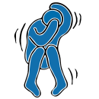




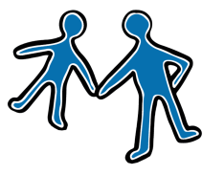
Content
This is us … S. 4
… when I realized what I am able to do! S. 6
… when I was able to help others! S. 8
… when others saw my strength! S. 12
… when I could learn something! S. 14
… when I was able to overcome my fear! S. 20
… when I was able to solve a problem! S. 28
… when I was clever in a dangerous situation! S. 32
… I realised that I am strong! S. 38
That was the Storytelling Club S. 42
The day …
3

Slide 4
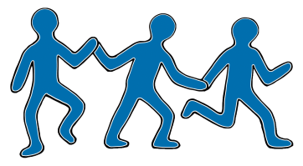

This is us …
4

Slide 5

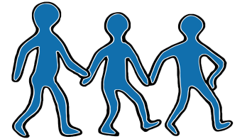
… and we are proud of this!
5

Slide 6

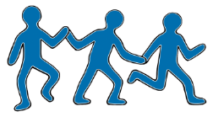

The day …
6

Slide 7

… when I realized
what I am able to do!
7

Slide 8

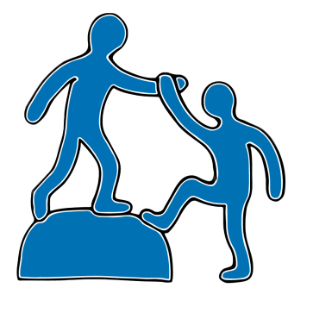
The day …
8

Slide 9

… when I was able to help others!
9

Slide 10
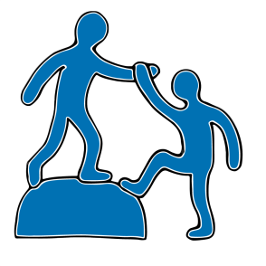
The day …
10

Slide 11
… when I was able to help others!
11

Slide 12



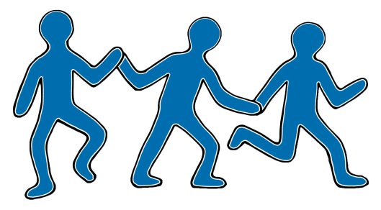
The day …
12

Slide 13
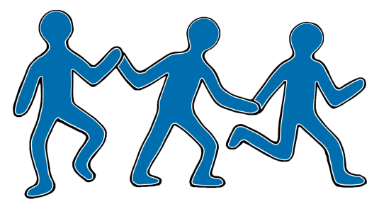
… when others saw my strength!
13

Slide 14



The day …
14

Slide 15


… when I could learn something!
15

Slide 16

The day…
16

Slide 17

… when I could learn something!
17

Slide 18
The day…
18

Slide 19
… when I could learn something!
19

Slide 20






The day…
20

Slide 21
… when I was able
to overcome my fear!
21

Slide 22
The day…
22

Slide 23
… when I was able
to overcome my fear!
23

Slide 24
The day…
24

Slide 25
… when I was able
to overcome my fear!
25

Slide 26

Tips …
26

Slide 27

… for dealing with fear
27

Slide 28


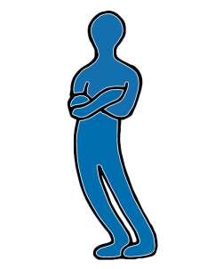
The day…
28

Slide 29

… when I was able
to solve a problem!
29

Slide 30

The day…
30

Slide 31
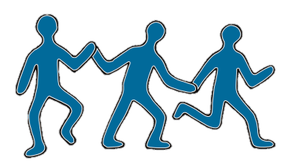
… when I was able
to solve a problem!
31

Slide 32



The day…
32

Slide 33
… when I was clever
in a dangerous situation!
33

Slide 34
The day…
34

Slide 35
… when I was clever
in a dangerous situation!
35

Slide 36


Tips …
36

Slide 37
… to deal with danger
37

Slide 38


The day…
38

Slide 39

… I realised that I am strong!
39

Slide 40
The day…
40

Slide 41

… I realised that I am strong!
41

Slide 42


That was…
42

Slide 43

… the Storytelling Club
43

Slide 44

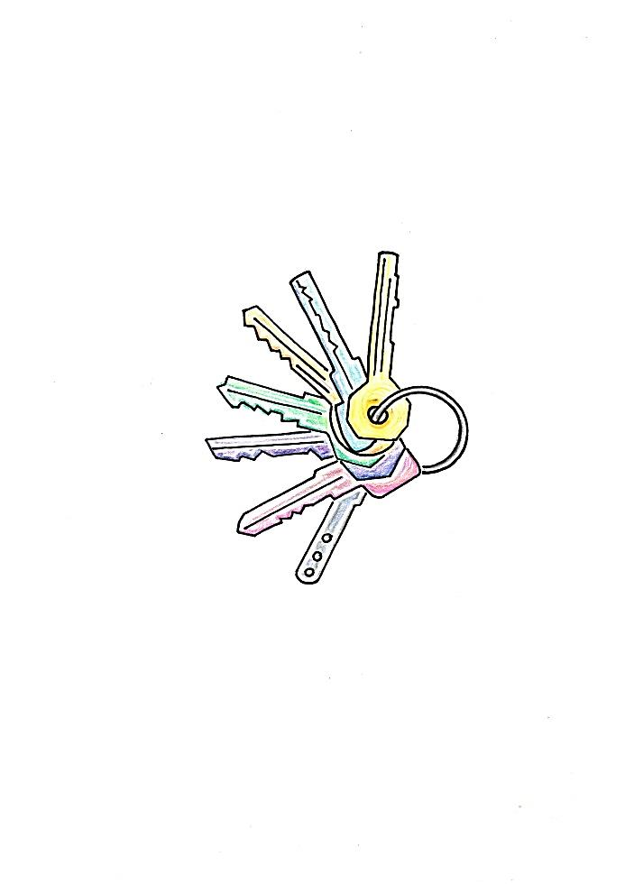
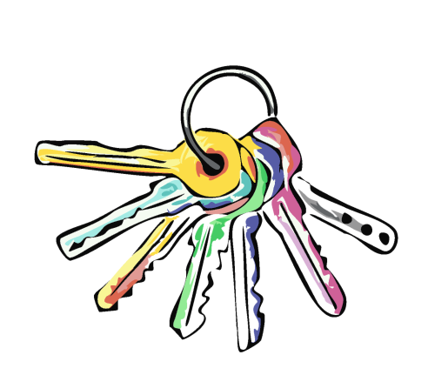

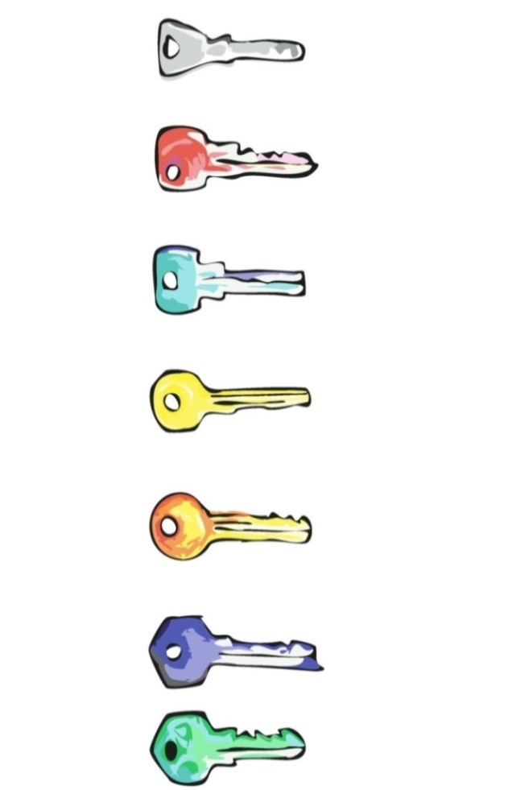
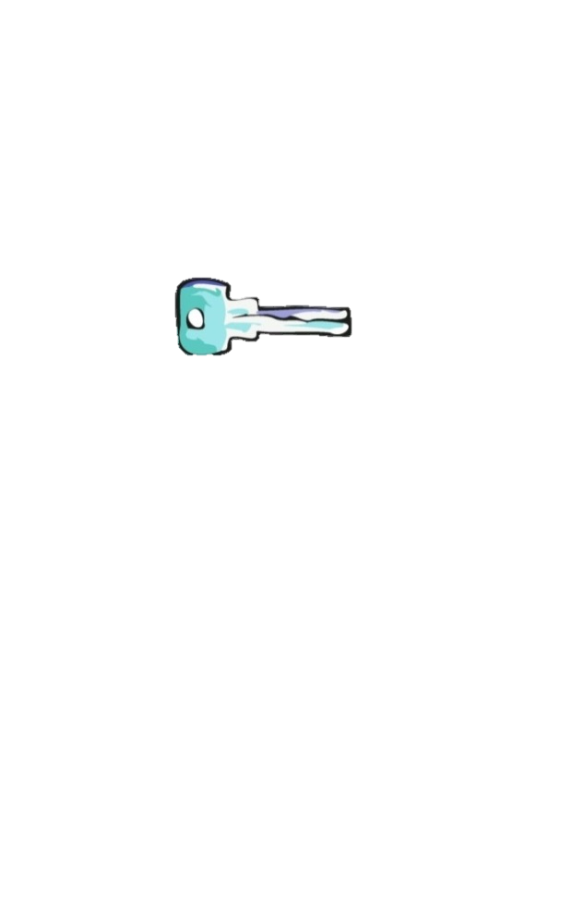




The 7 keys to your own strength
1. Be aware of what is going on
and be honest how you and others feel.
2. Know what you are good at,
be proud of it and also see the strengths of others.
3. Allow yourself to learn and
make mistakes.
You don´t have to know
everything right away.
4. Remember: Every problem has different solutions.
Think creatively and in different directions.
5. Go for it! It’ll bring you further in life.
6. See the positive sides! And all the things that you already have mastered.
7. Trust yourself and look for support! You don’t have to solve everything alone.

